Slide 1
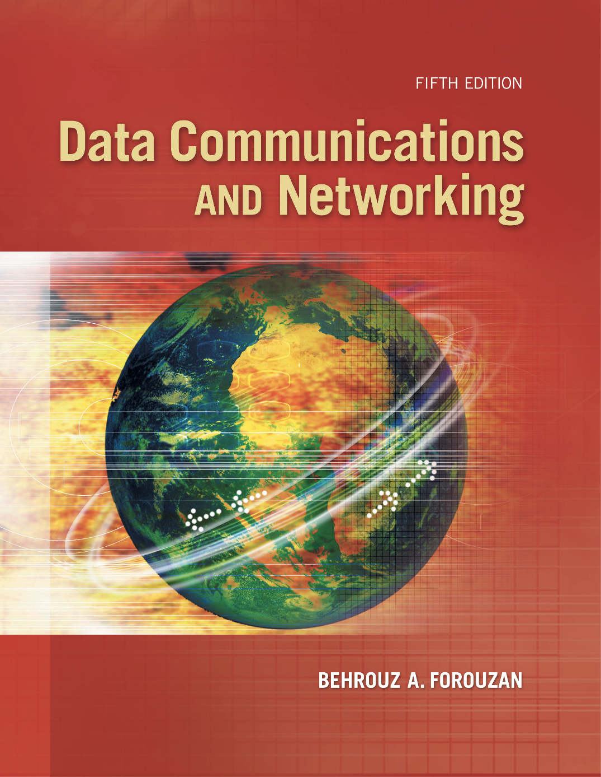
Chapter 12
Media Access
Control
(MAC)
Copyright © The McGraw-Hill Companies, Inc. Permission required for reproduction or display.
Notes:
1

Slide 2
Chapter 5: Outline
12.1 RANDOM ACCESS
12.2 CONTROLLED ACCESS
12.3 CHANNELIZATION
Notes:
12.#

Slide 3

Chapter 12: Objective
The first section discusses random-access protocols. Four protocols, ALOHA, CSMA, CSMA/CD, and CSMA/CA, are described in this section. These protocols are mostly used in LANs and WANs, which we discuss in future chapters.
The second section discusses controlled-access protocols. Three protocols, reservation, polling, and token-passing, are described in this section. Some of these protocol are used in LANs, but others have some historical value.
The third section discusses channelization protocols. Three protocols, FDMA, TDMA, and CDMA are described in this section. These protocols are used in cellular telephony, which we discuss in Chapter 16.
Notes:
12.#

Slide 4
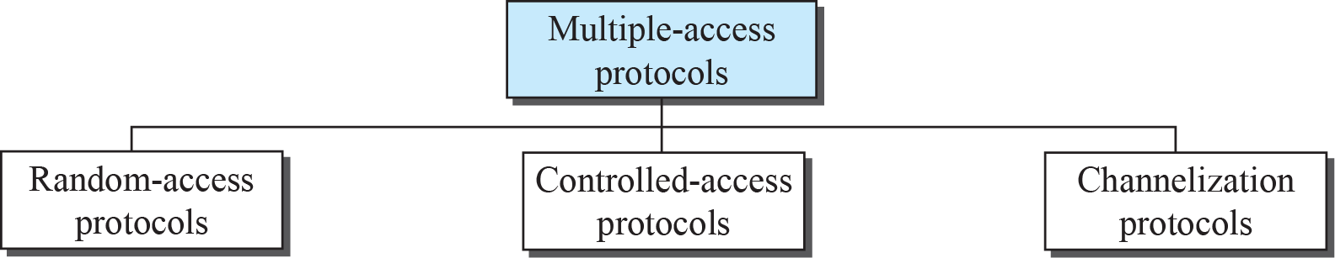
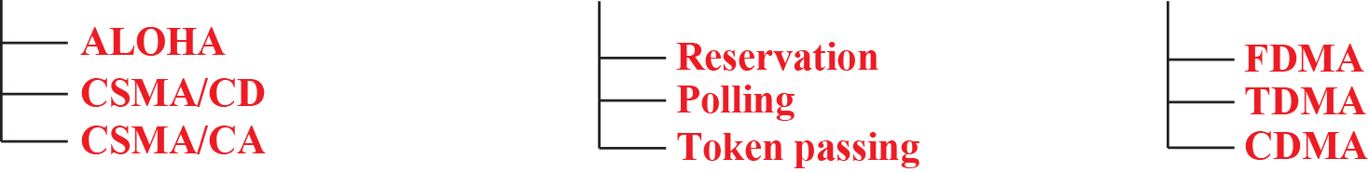
Figure 12.1: Taxonomy of multiple-access protocols
CD=Collossion detection
CA=Collossion Avoidence
CSMA/CD=Carriear sense multiple access
FDMA=Frequency devison multiple access
TDMA=Time devision Multiple Access
CDMA=Code devision multiple access
12.4
Notes:
12.#

Slide 5
12-1 RANDOM ACCESS
In random-access or contention no station is superior to another station and
none is assigned control over another. At each instance, a station that has data to send uses a procedure defined by the protocol to make a decision on whether or not to send. This decision depends on the state of the medium (idle or busy).
12.5
Notes:
12.#

Slide 6
12.12.1 ALOHA
ALOHA, the earliest random access method, was developed at the University of Hawaii in early 1970. It was designed for a radio (wireless) LAN, but it can be used on any shared medium. It is obvious that there are potential collisions in this arrangement. The medium is shared between the stations. When a station sends data, another station may attempt to do so at the same time. The data from the two stations collide and become garbled.
S=Ge^{-2G}
S=Throughput of the system,representing the average no of successful transmission per frame
G=is the average no of transmission attempts per frame time (both success and unsuccess)
12.6
Notes:
12.#

Slide 7
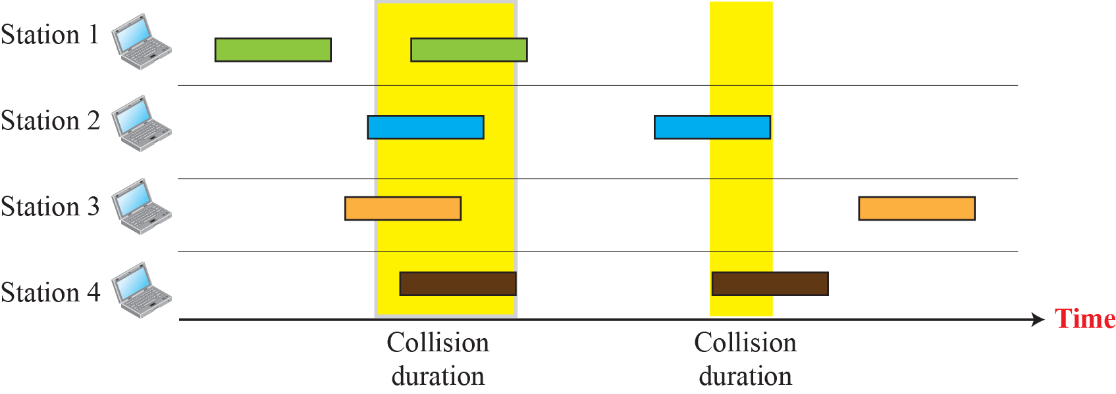
Figure 12.2: Frames in a pure ALOHA network
12.7
Notes:
12.#

Slide 8
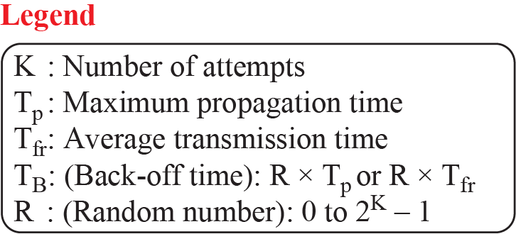
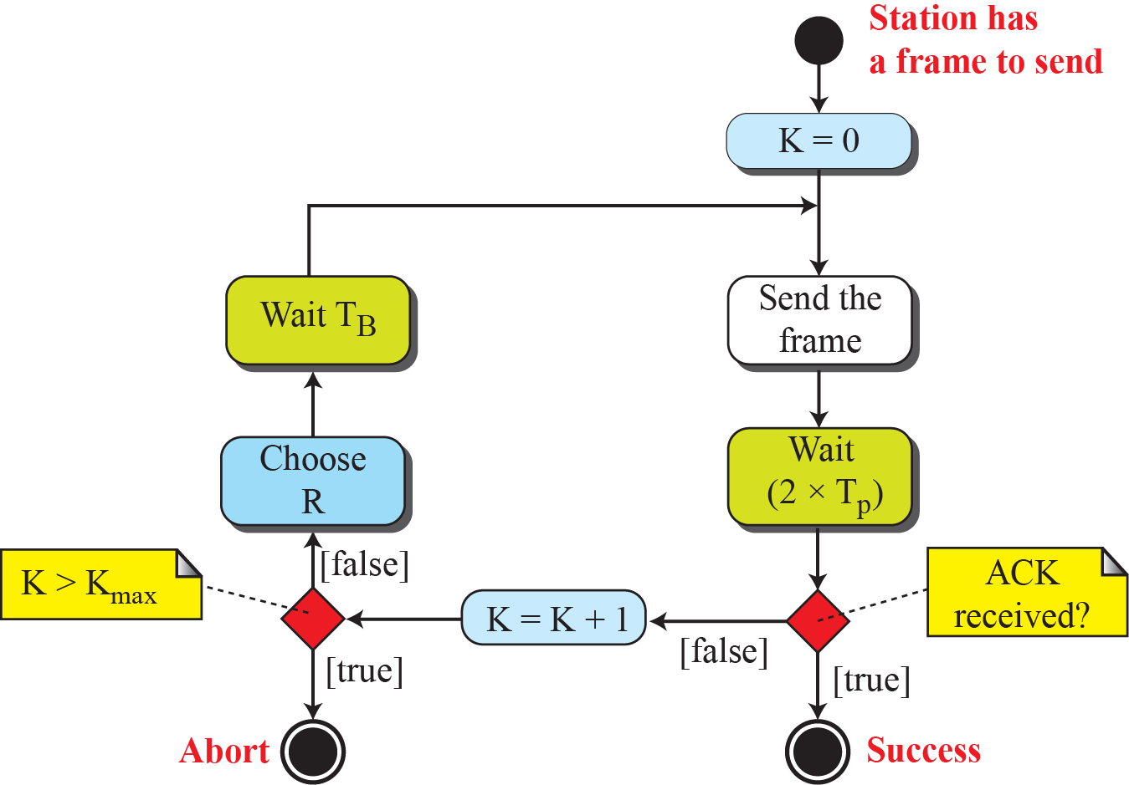
Figure 12.3: Procedure for pure ALOHA protocol
12.8
Notes:
12.#

Slide 9
Example 12. 1
The stations on a wireless ALOHA network are a maximum of 600 km apart. If we assume that signals propagate at 3 × 10⁸ m/s, we find T_{p} = (600 × 10³) / (3 × 10⁸) = 2 ms. For K = 2, the range of R is {0, 1, 2, 3}. This means that T_{B} can be 0, 2, 4, or 6 ms, based on the outcome of the random variable R.
R={0,1,2,3}
T_{p}=2
T_{B}=R*T_{p}
={0 2 4 6}
12.9
Notes:
9

Slide 10
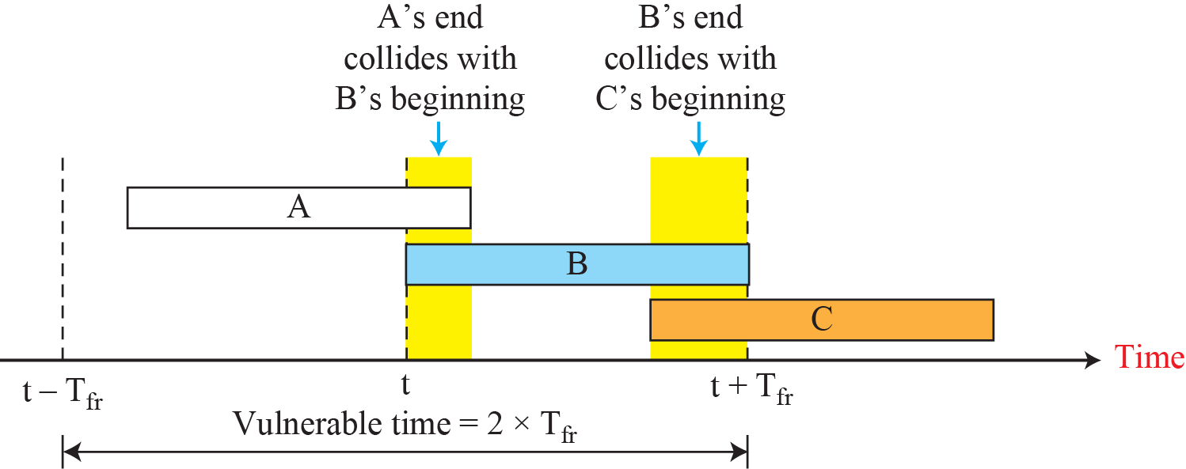
Figure 12.4: Vulnerable time for pure ALOHA protocol
Pure AlOHA Vulnerable Time=2* T_{fr}
T_{fr}=station send fixed length frames with each frames taking T_{fr} seconds
12.10
Notes:
12.#

Slide 11
Example 12.2
A pure ALOHA network transmits 200-bit frames on a shared channel of 200 kbps. What is the requirement to make this frame collision-free?
Solution
Average frame transmission time T_{fr} is 200 bits/200 kbps or 1 ms. The vulnerable time is 2 × 1 ms = 2 ms. This means no station should send later than 1 ms before this station starts transmission and no station should start sending during the period (1 ms) that this station is sending.
12.11
Notes:
11

Slide 12
Example 12. 3
A pure ALOHA network transmits 200-bit frames on a shared channel of 200 kbps. What is the throughput if the system (all stations together) produces
a. 1000 frames per second?
b. 500 frames per second?
c. 250 frames per second?
The throughput for pure ALOHA=S=G*e^{-2G}
Max throughput S_{max}=1/2e=0.184
When G=1/2
Solution
The frame transmission time is 200/200 kbps or 1 ms.
a. If the system creates 1000 frames per second, or 1 frame per millisecond, then G = 1. In this case S = G × e^{−2G} =
0.135 (13.5 percent). This means that the throughput is 1000 × 0.135 = 135 frames. Only 135 frames out of 1000 will probably survive.
12.12
Notes:
12

Slide 13
Example 12. 3 (continued)
b. If the system creates 500 frames per second, or 1/2 frames per millisecond, then G = 1/2. In this case S = G × e^{−2G} = 0.184 (18.4 percent). This means that the throughput is
500 × 0.184 = 92 and that only 92 frames out of 500 will
probably survive. Note that this is the maximum throughput case, percentage-wise.
c. If the system creates 250 frames per second, or 1/4 frames per millisecond, then G = 1/4. In this case S = G × e^{−2G} = 0.152 (15.2 percent). This means that the
throughput is 250 × 0.152 = 38. Only 38 frames out of 250 will probably survive
12.13
Notes:
13

Slide 14
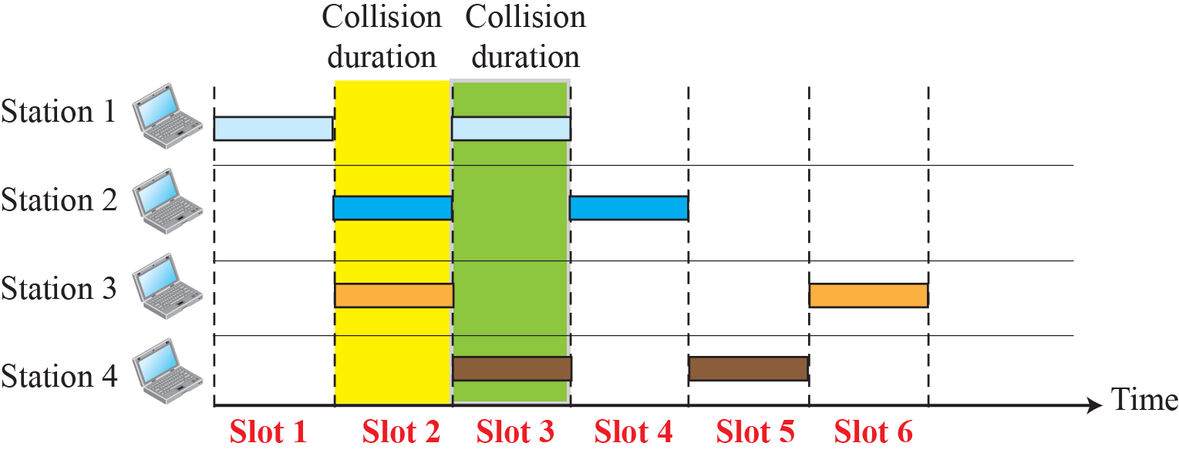
Figure 12.5: Frames in a slotted ALOHA network
12.14
Notes:
12.#

Slide 15
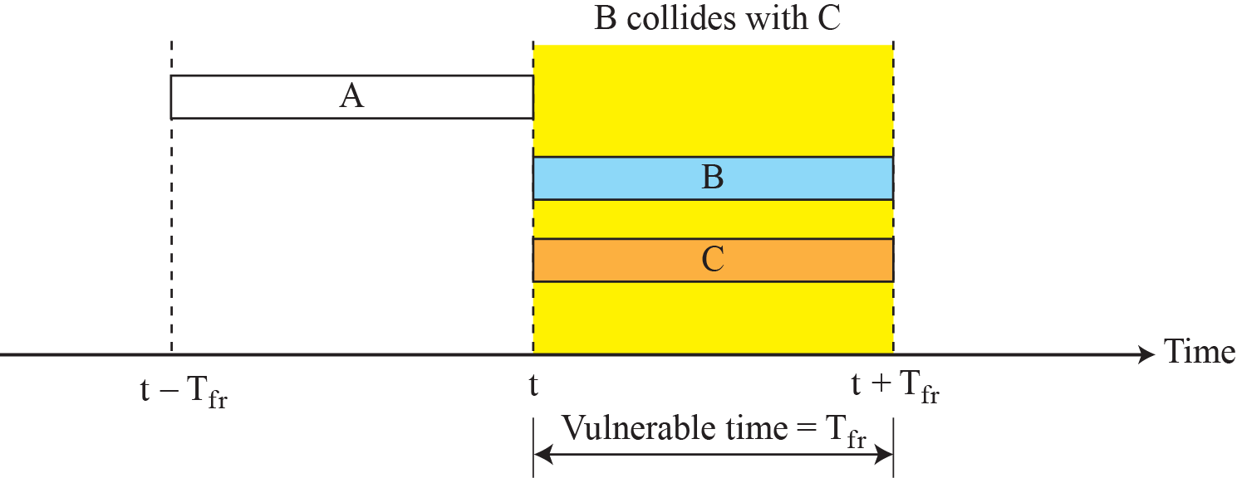
Figure 12.6: Vulnerable time for slotted ALOHA protocol
12.15
Notes:
12.#

Slide 16
Example 12. 4
A slotted ALOHA network transmits 200-bit frames using a shared channel with a 200-kbps bandwidth. Find the throughput if the system (all stations together) produces
a. 1000 frames per second.
b. 500 frames per second.
c. 250 frames per second.
Solution
This situation is similar to the previous exercise except that the network is using slotted ALOHA instead of pure ALOHA. The frame transmission time is 200/200 kbps or 1 ms.
The throughput for slotted ALOHA=S=G*e^{-G}
Max throughput S_{max=0.368} when G=1
12.16
Notes:
16

Slide 17
Example 12. 4 (continued)
In this case G is 12. So S = G × e^{−G} = 0.368 (36.8 percent). This means that the throughput is 1000 × 0.0368 = 368 frames. Only 368 out of 1000 frames will probably survive. Note that this is the maximum throughput case, percentage-wise.
Here G is 1/2. In this case S = G × e^{−G} = 0.303 (30.3 percent). This means that the throughput is 500 × 0.0303 = 151. Only 151 frames out of 500 will probably survive.
Now G is 1/4. In this case S = G × e^{−G} = 0.195 (19.5 percent). This means that the throughput is 250 × 0.195 = 49. Only 49 frames out of 250 will probably survive.
12.17
Notes:
17

Slide 18
12.12.2 CSMA
To minimize the chance of collision and, therefore, increase the performance, the CSMA method was developed. The chance of collision can be reduced if a station senses the medium before trying to use it. Carrier sense multiple access (CSMA) requires that each station first listen to the medium (or check the state of the medium) before sending. In other words, CSMA is based on the principle “sense before transmit” or “listen before talk.”
12.18
Notes:
12.#

Slide 19
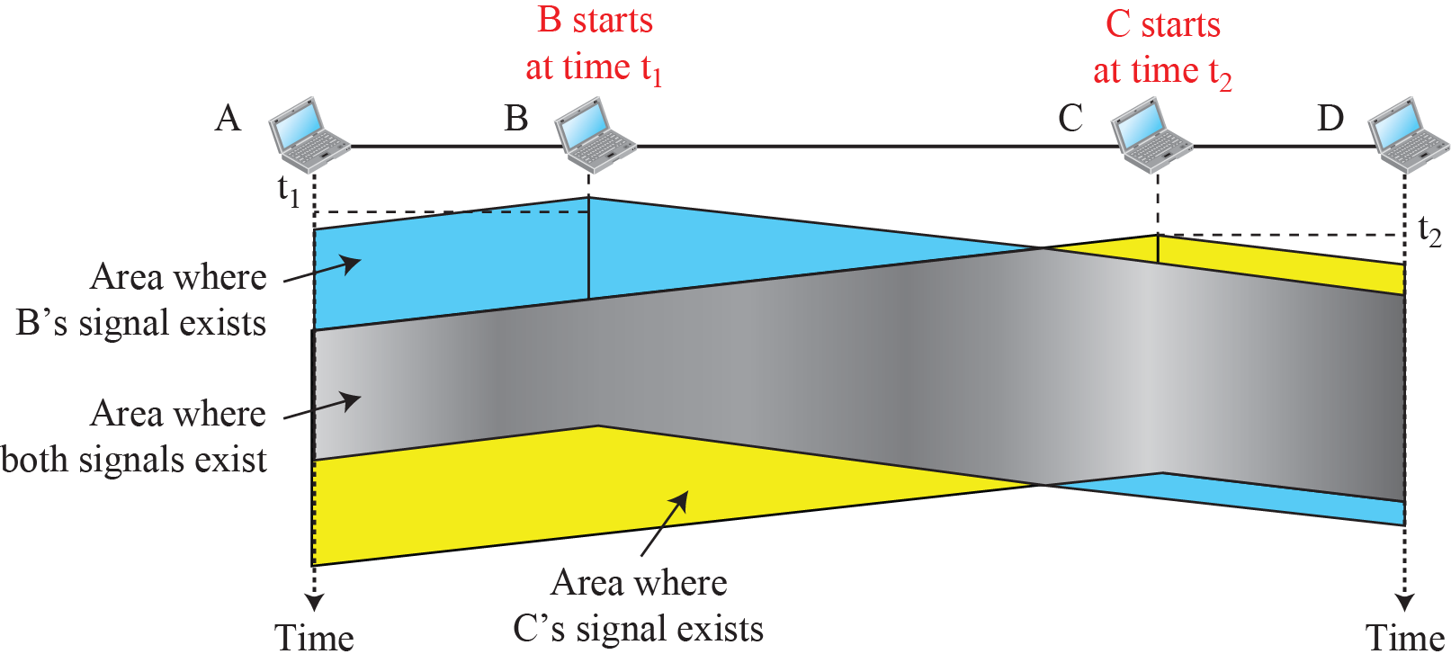
Figure 12.7: Space/time model of a collision in CSMA
12.19
Notes:
12.#

Slide 20
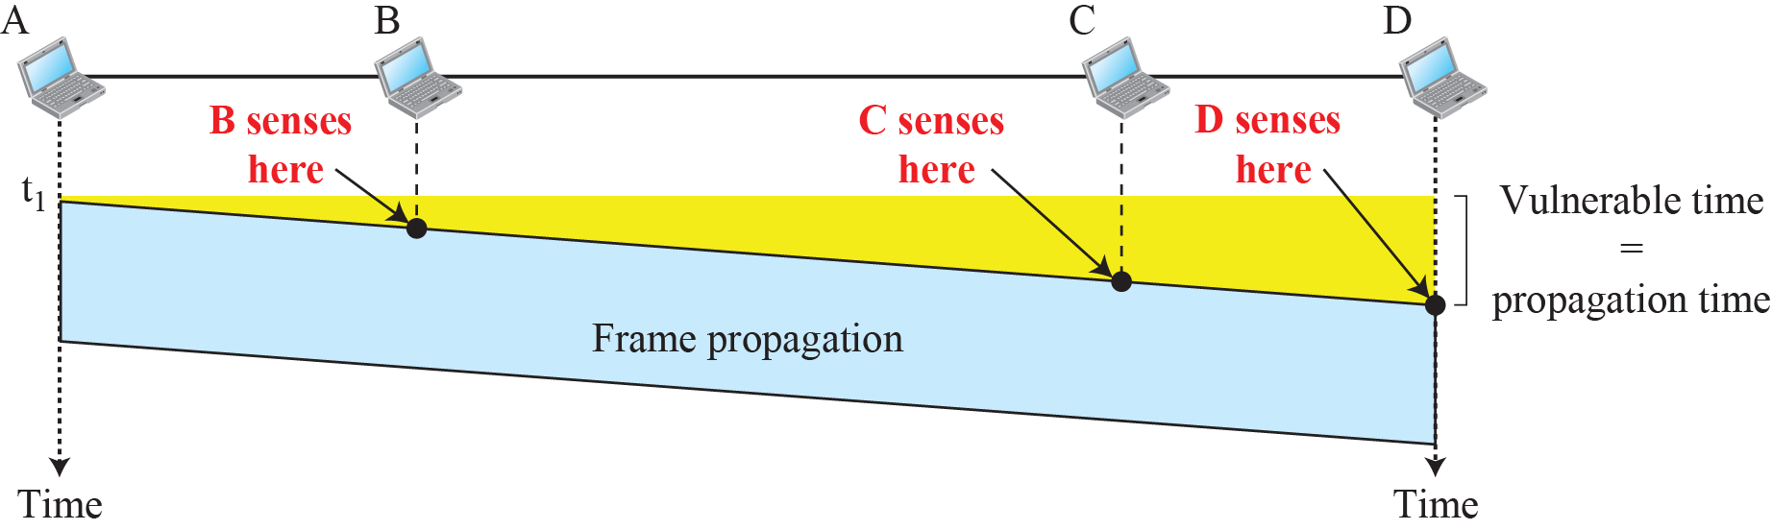
Figure 12.8: Vulnerable time in CSMA
12.20
Notes:
12.#

Slide 21
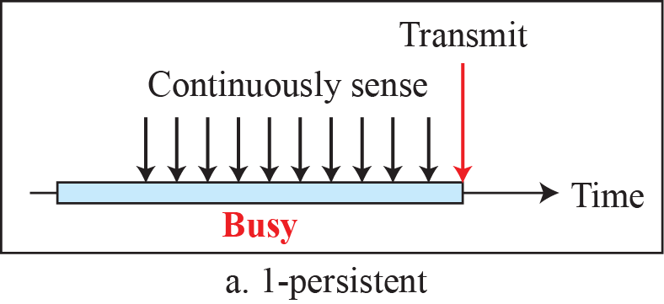
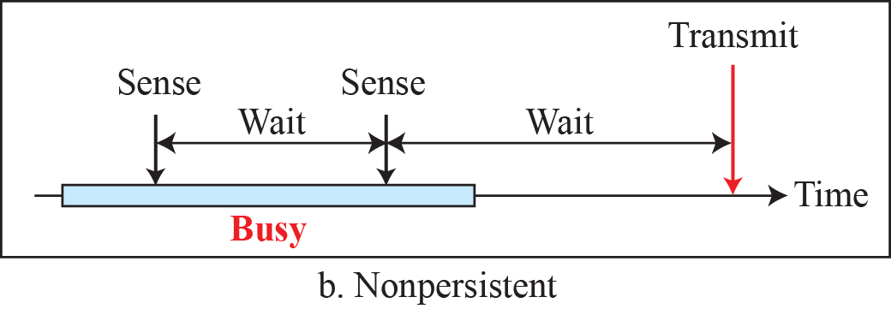
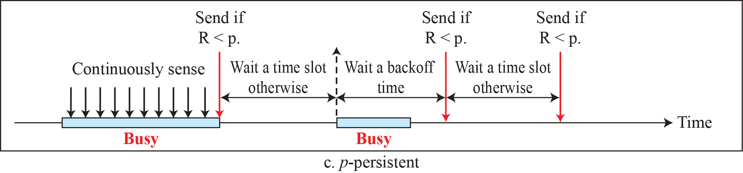
Figure 12.9: Behavior of three persistence methods
Here R=Generate Random n
P=Find Probability
12.21
Notes:
12.#

Slide 22
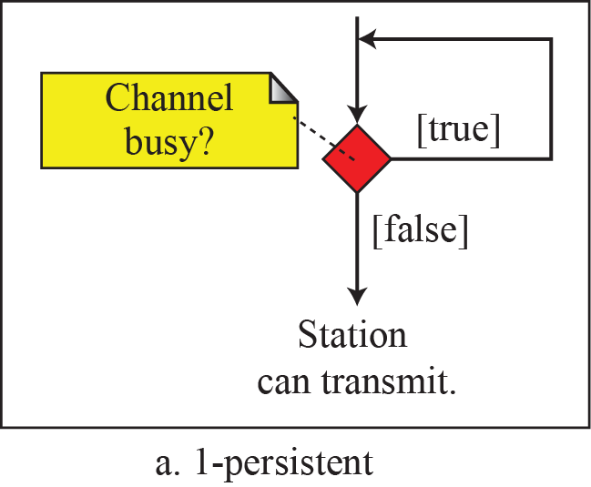
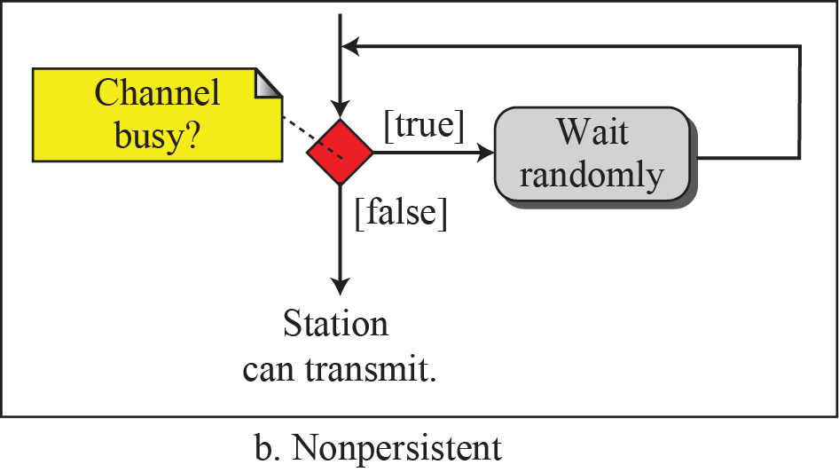
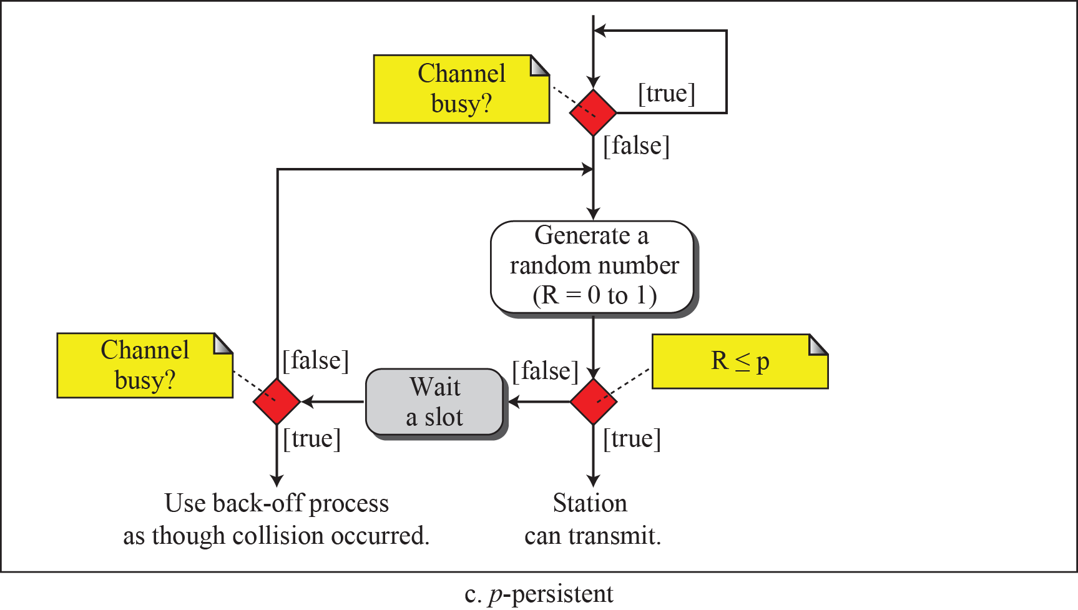
Figure 12.10: Flow diagram for three persistence methods
12.22
Notes:
12.#

Slide 23
12.12.3 CSMA/CD
The CSMA method does not specify the procedure following a collision. Carrier sense multiple access with collision detection (CSMA/CD) augments the algorithm to handle the collision.
In this method, a station monitors the medium after it sends a frame to see if the transmission was successful. If so, the station is finished. If, however, there is a collision, the frame is sent again.
12.23
Notes:
12.#

Slide 24
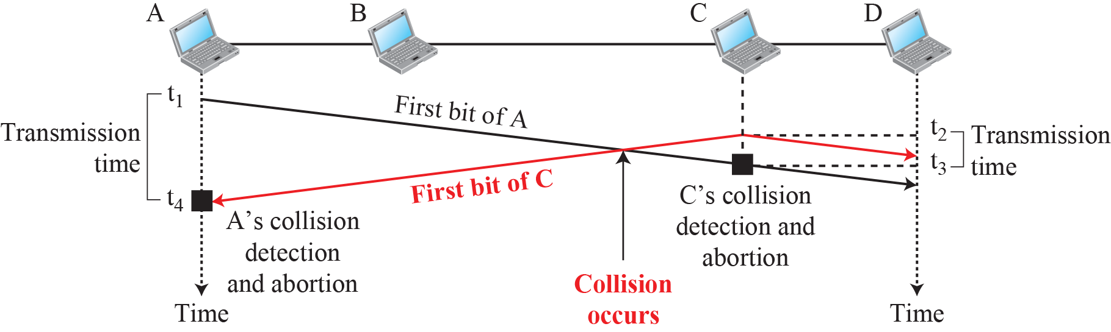
Figure 12.11: Collision of the first bits in CSMA/CD
12.24
Notes:
12.#

Slide 25
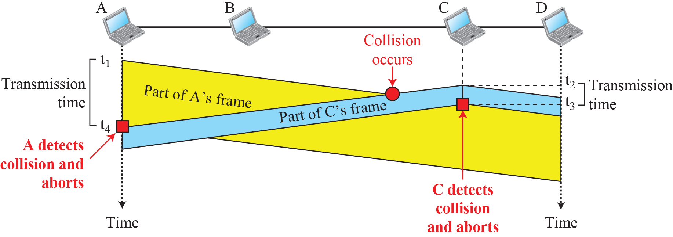
Figure 12.12: Collision and abortion in CSMA/CD
12.25
Notes:
12.#

Slide 26
Example 12. 5
A network using CSMA/CD has a bandwidth of 10 Mbps. If the maximum propagation time (including the delays in the devices and ignoring the time needed to send a jamming signal, as we see later) is 25.6 μs, what is the minimum size of the frame?
Solution
The minimum frame transmission time is T_{fr} = 2 × T_{p} = 51.2 μs. This means, in the worst case, a station needs to transmit for a period of 51.2 μs to detect the collision. The minimum size of the frame is 10 Mbps × 51.2 μs = 512 bits or 64 bytes. This is actually the minimum size of the frame for Standard Ethernet, as we will see later in the chapter.
2 * 25.6=51.2
12.26
Notes:
26

Slide 27
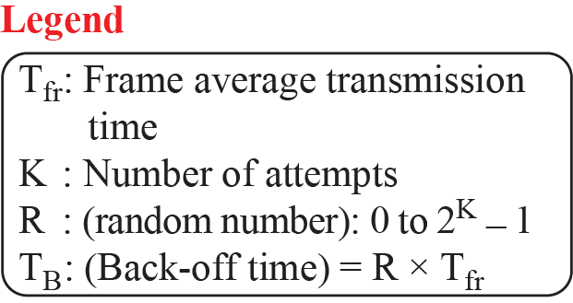
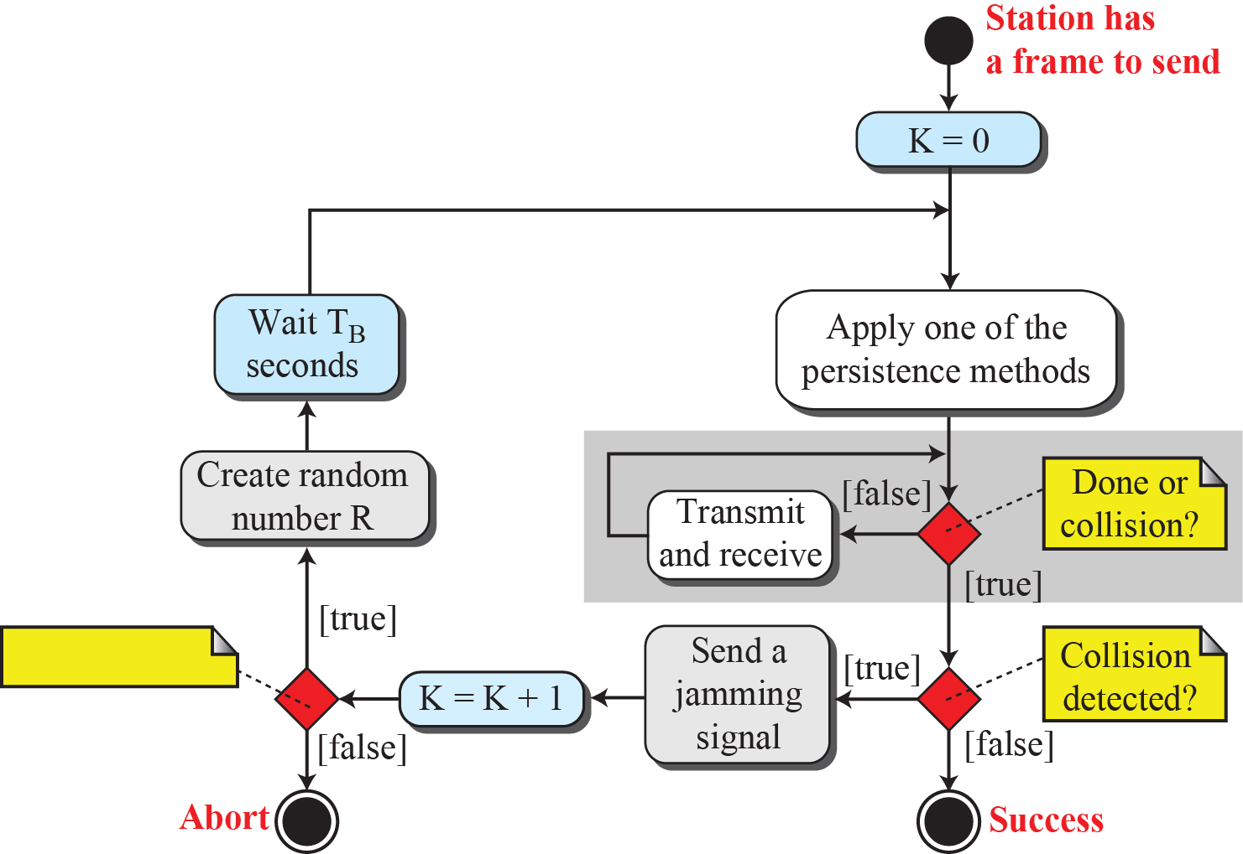
Figure 12.13: Flow diagram for the CSMA/CD
12.27
Notes:
12.#

Slide 28
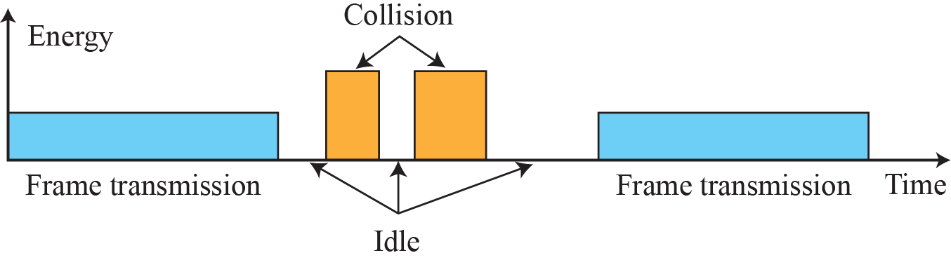
Figure 12.14: Energy level during transmission, idleness, or collision
12.28
Notes:
12.#

Slide 29
12.12.4 CSMA/CA
Carrier sense multiple access with collision avoidance (CSMA/CA) was invented for wireless networks. Collisions are avoided through the use of CSMA/CA’s three strategies: the interframe space, the contention window, and acknowledgments, as shown in Figure 12.15. We discuss RTS and CTS frames later.
12.29
Notes:
12.#

Slide 30
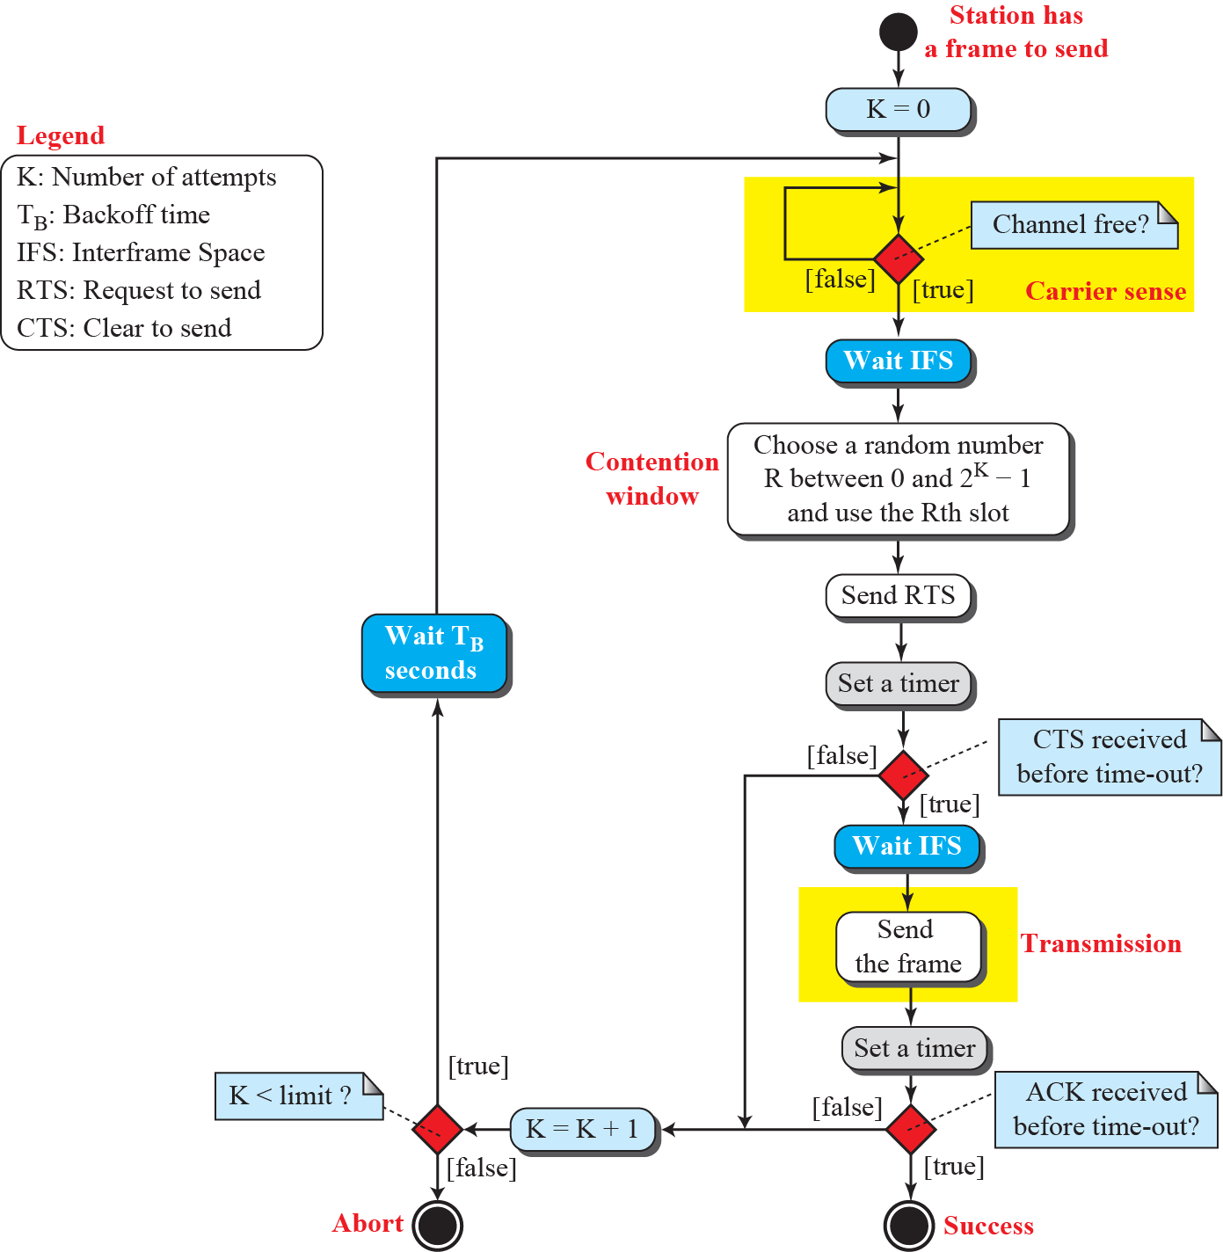
Figure 12.15: Flow diagram for CSMA/CA
12.30
Notes:
12.#

Slide 31
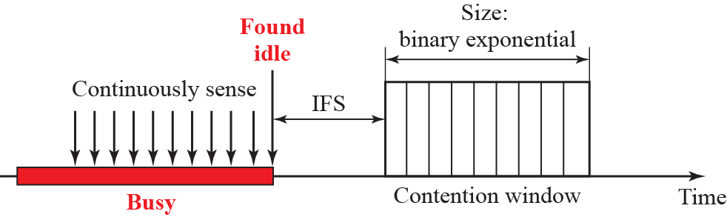
Figure 12.16: Contention window
12.31
Notes:
12.#

Slide 32
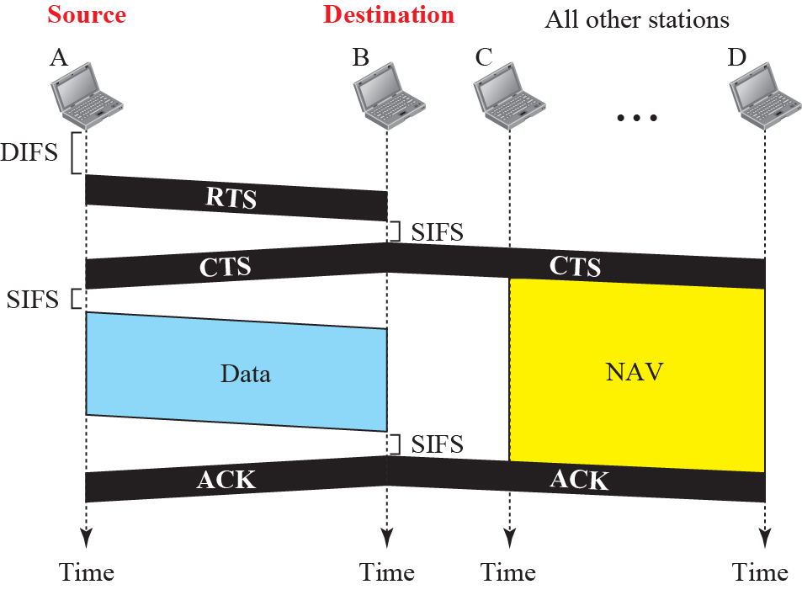
Figure 12.17: CMACA and NAV
12.32
Notes:
12.#

Slide 33
12-2 CONTROLLED ACCESS
In controlled access, the stations consult one another to find which station has the right to send. A station cannot send unless it has been authorized by other stations. We discuss
three controlled-access methods.
12.33
Notes:
12.#

Slide 34
12.2.1 Reservation
In the reservation method, a station needs to make a reservation before sending data. Time is divided into intervals. In each interval, a reservation frame precedes the data frames sent in that interval.
12.34
Notes:
12.#

Slide 35
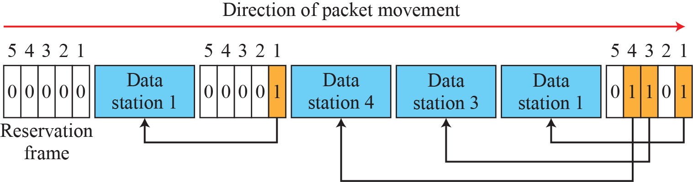
Figure 12.18: Reservation access method
12.35
Notes:
12.#

Slide 36
12.2.2 Polling
Polling works with topologies in which one device is designated as a primary station and the other devices are secondary stations. All data exchanges must be made through the primary device even when the ultimate destination is a secondary device. The primary device controls the link; the secondary devices follow its instructions. It is up to the primary
device to determine which device is allowed to use the channel at a given time.
12.36
Notes:
12.#

Slide 37


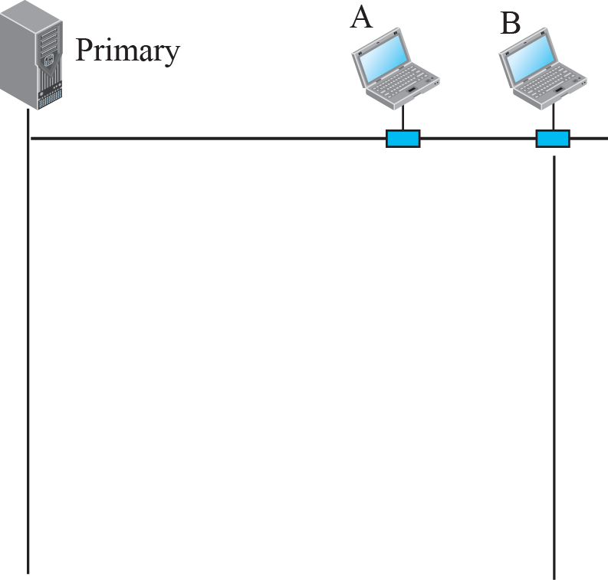
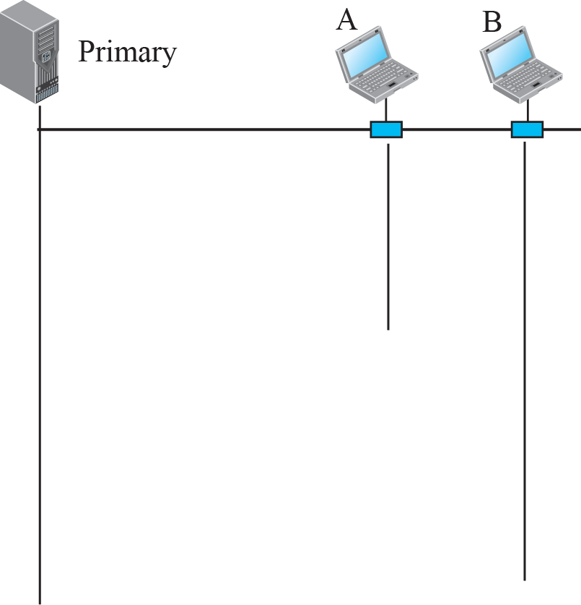
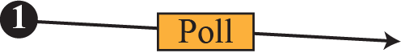
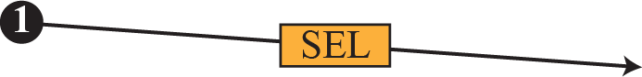
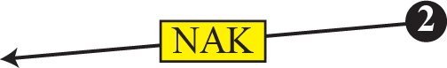
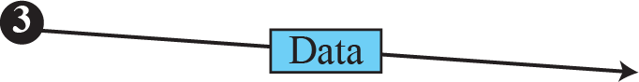
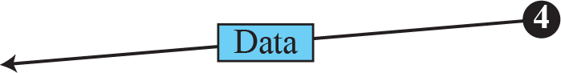
Figure 12.19: Select and poll functions in polling-access method
12.37
Notes:
12.#

Slide 38
12.2.3 Token Passing
In the token-passing method, the stations in a network are organized in a logical ring. In other words, for each station, there is a predecessor and a successor. The predecessor is the station which is logically before the station in the ring; the successor is the station which is after the station in the ring.
12.38
Notes:
12.#

Slide 39
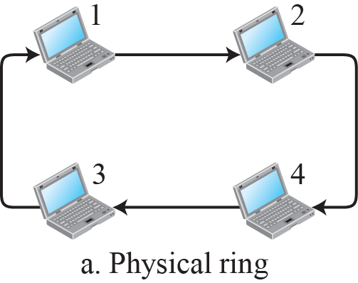
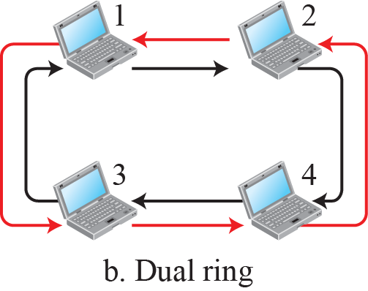
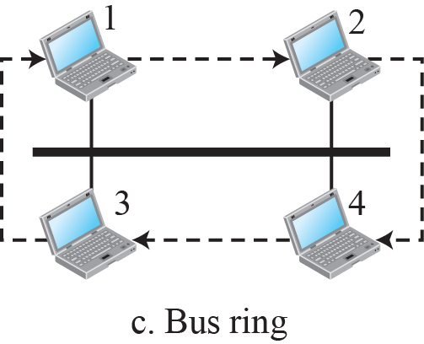
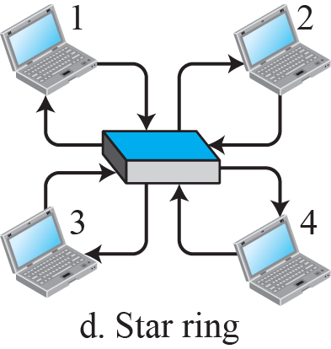
Figure 12.20: Logical ring and physical topology in token-passing
access method
12.39
Notes:
12.#

Slide 40
12-3 CHANNELIZATION
Channelization (or channel partition, as it is sometimes called) is a multiple-access
method in which the available bandwidth of a link is shared in time, frequency, or
through code, among different stations. In this section, we discuss three protocols: FDMA, TDMA, and CDMA.
Diff between FDMA and prev we saw FHMA and other TDMA and CDMA
12.40
Notes:
12.#

Slide 41
12.3.1 FDMA
In frequency-division multiple access (FDMA), the available bandwidth is divided into frequency bands. Each station is allocated a band to send its data. In other words, each band is reserved for a specific station, and it belongs to the station all the time. Each station also uses a bandpass filter to confine the transmitter frequencies. To prevent
12.41
Notes:
12.#

Slide 42
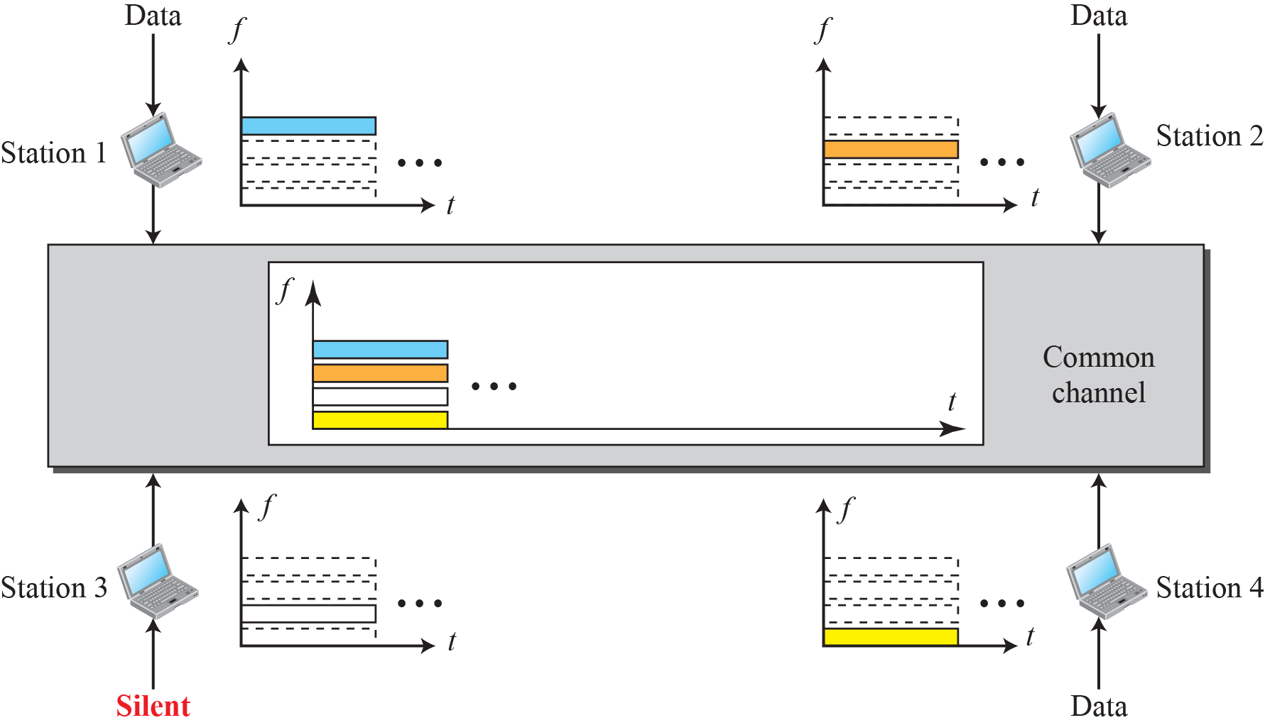
Figure 12.21: Frequency-division multiple access (FDMA)
12.42
Notes:
12.#

Slide 43
12.3.2 TDMA
In time-division multiple access (TDMA), the stations share the bandwidth of the channel in time. Each station is allocated a time slot during which it can send data. Each station transmits its data in its assigned time slot. Figure 12.22 shows the idea behind TDMA.
12.43
Notes:
12.#

Slide 44
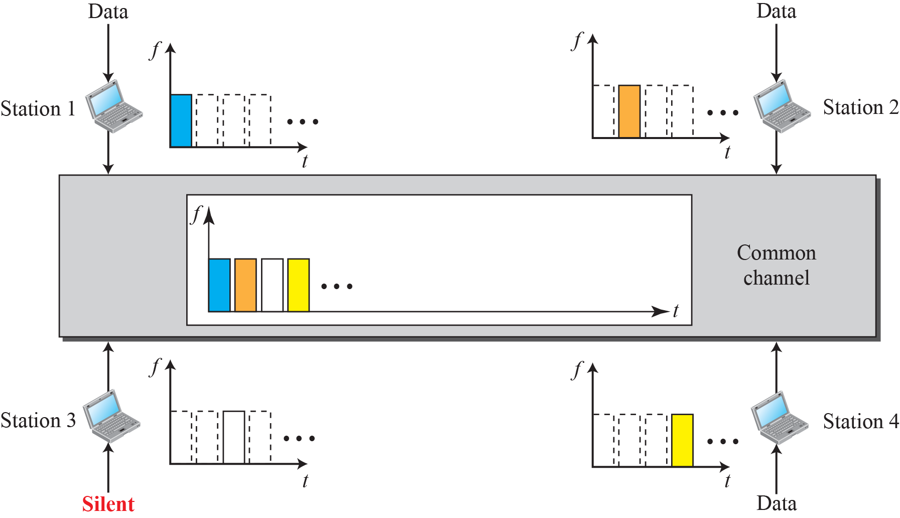
Figure 12.22: Time-division multiple access (TDMA)
12.44
Notes:
12.#

Slide 45
12.3.3 CDMA
Code-division multiple access (CDMA) was conceived several decades ago. Recent advances in electronic technology have finally made its implementation possible. CDMA differs from FDMA in that only one channel occupies the entire bandwidth of the link. It differs from TDMA in that all stations can send data simultaneously; there is no timesharing.
12.45
Notes:
12.#

Slide 46
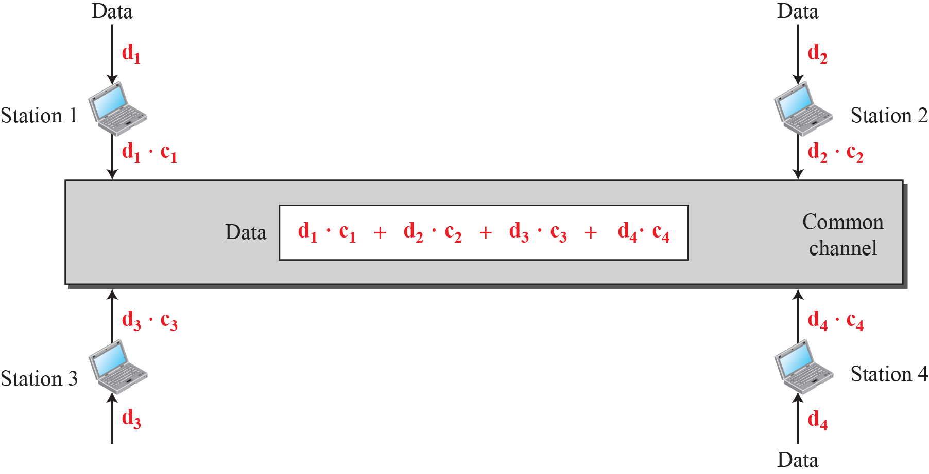
Figure 12.23: Simple idea of communication with code
C=Chipsequence (Collection of 1,-1,0)
D=bit
12.46
Notes:
12.#

Slide 47
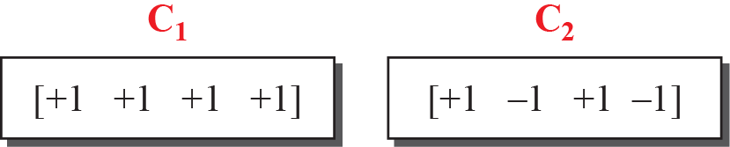
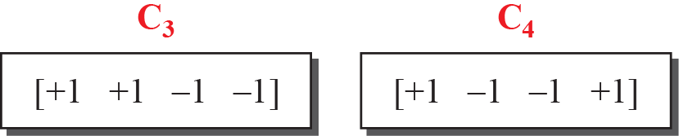
Figure 12.24: Chip sequences
12.47
Notes:
12.#

Slide 48
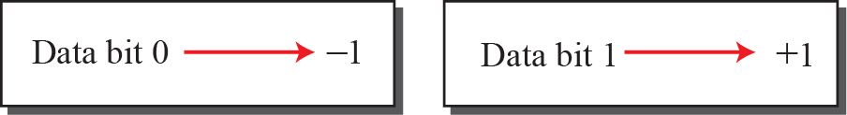
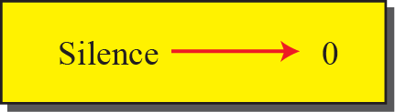
Figure 12.25: Data representation in CDMA
12.48
Notes:
12.#

Slide 49
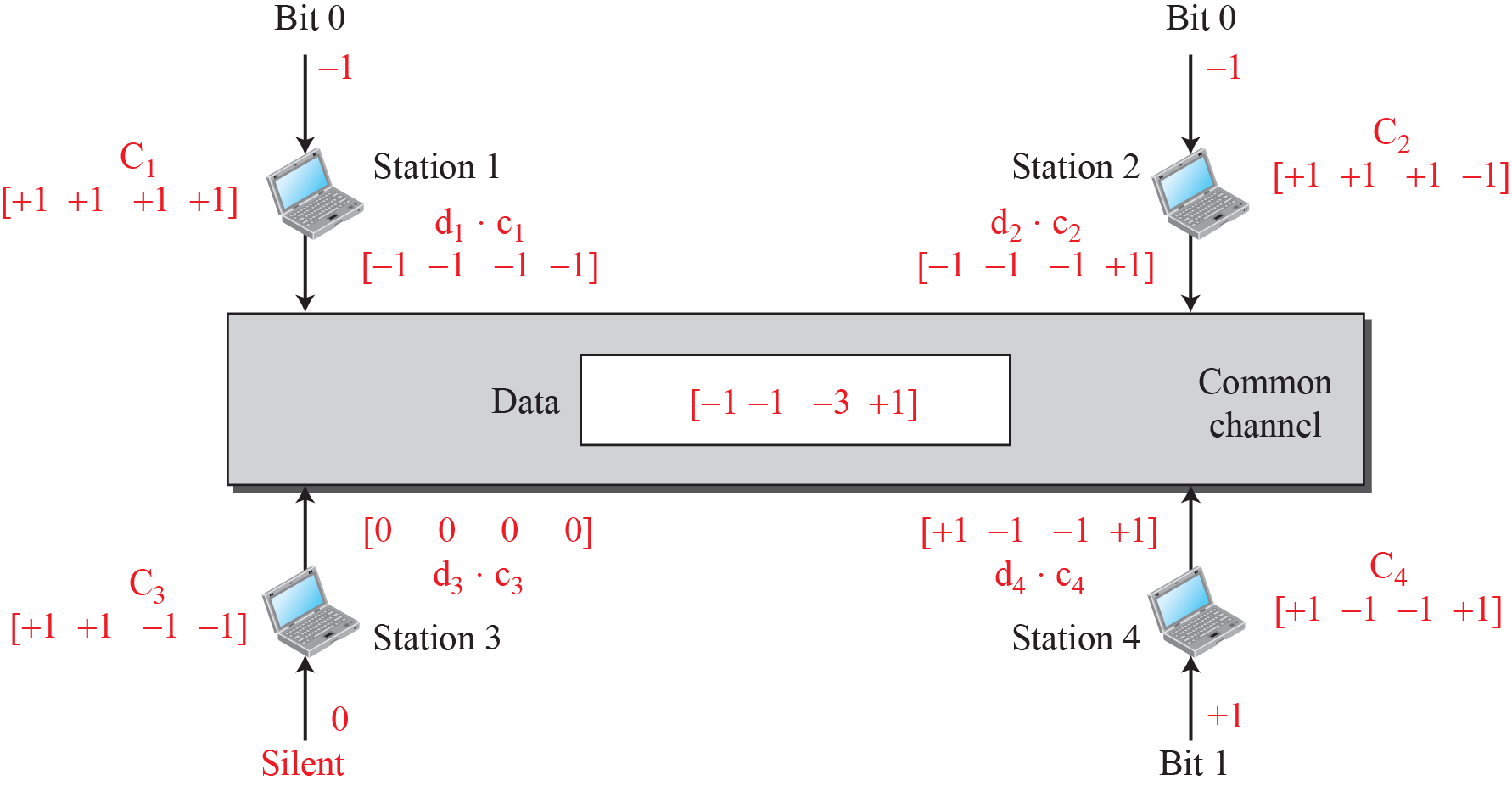
Figure 12.26: Sharing channel in CDMA
0-1-1+1=-1
12.49
Notes:
12.#

Slide 50
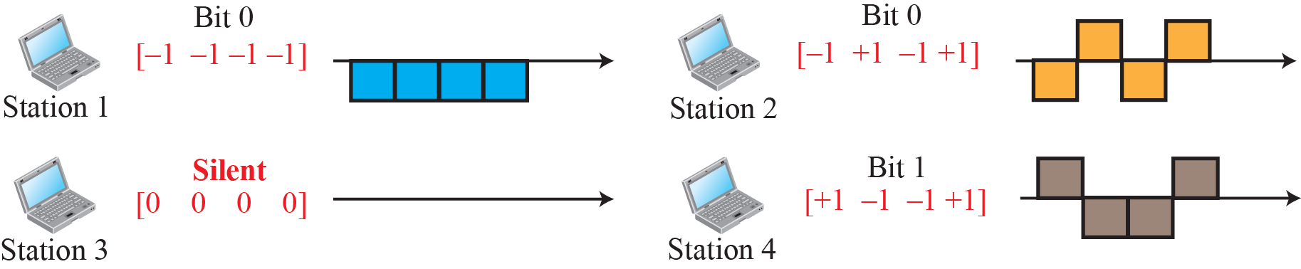
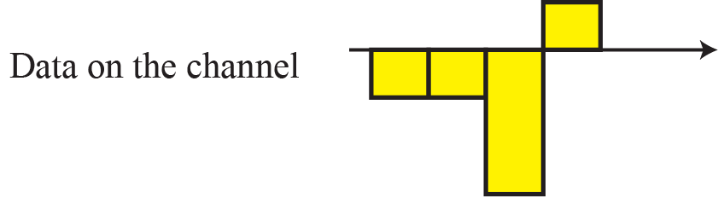
Figure 12.27: Digital signal created by four stations in CDMA
12.50
Notes:
12.#

Slide 51
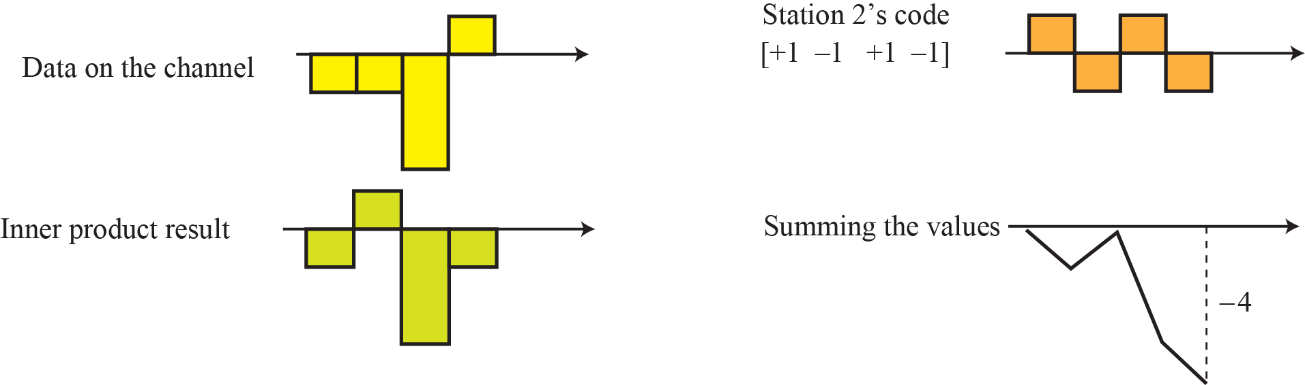
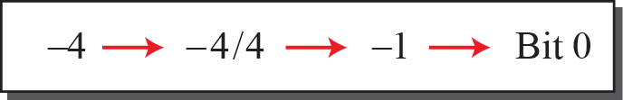
Figure 12.28: Decoding of the composite signal for one in CDMA
-1+1-3-1=-4
12.51
Notes:
12.#

Slide 52
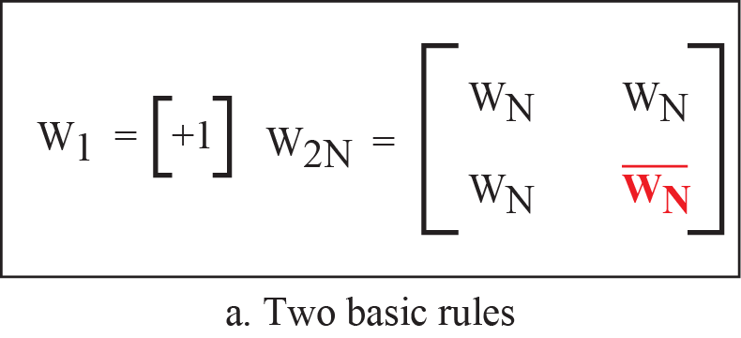

Figure 12.29: General rules and examples of creating Walsh tables
2^{n}=2 4 8
Here 2N=denote no of rows
12.52
Notes:
12.#

Slide 53

Example 12.6
Find the chips for a network with
a. Two stations
b. Four stations
12.53
Notes:
53

Slide 54

Example 12. 7
What is the number of sequences if we have 90 stations in our network?
No of sequences needs station = 2^{m}
12.54
Notes:
54

Slide 55

Example 12.8
Prove that a receiving station can get the data sent by a specific sender if it multiplies the entire data on the channel by the sender’s chip code and then divides it by the number of stations.
12.55
Notes:
55

